Slide 1



Introduction to Vision Transformer
Vision Transformers (ViT) are a revolutionary deep learning model that have recently emerged as a powerful alternative to traditional Convolutional Neural Networks (CNNs) for a wide range of computer vision tasks. Unlike CNNs, which rely on local feature extraction convolutional operations, ViTs leverage the power of self-attention mechanisms to capture long-range dependencies and global contextual information in visual data. This presentation will provide a comprehensive overview of vision transformers, exploring their underlying architecture, mathematical foundations, advantages over CNNs, and their diverse applications across various industries.

Slide 2
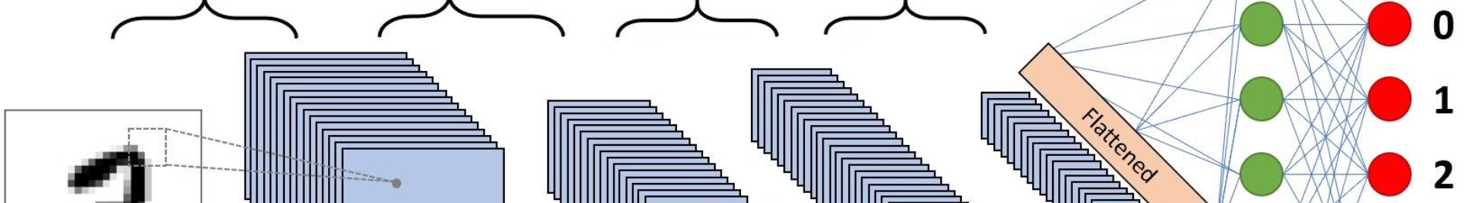
Convolutional Neural Networks (CNNs) and their limitations
1
Local Feature Extraction
2
Inductive Bias
3
Scalability Challenges
Convolutional Neural Networks (CNNs) are highly effective at extracting local features from visual data, such as edges, shapes, and textures, through the use of convolutional layers and pooling operations. This makes them well-suited for tasks like image classification and object detection.
CNNs have an inherent inductive bias towards learning local, translation-invariant features, which can be limiting when dealing with complex, long-range dependencies in visual data.
As the size and complexity of visual data increases, the computational and memory requirements of CNNs can become prohibitive, making them less scalable to larger, high-resolution images or video data.

Slide 3
Attention Mechanism in Vision Transformers
Self-Attention
Multi-Head Attention
The core of the Vision Transformer architecture is the self-attention mechanism, which allows the model to dynamically weigh the importance of different regions of an input image when making predictions. This enables the model to capture long-range dependencies and global context, overcoming the local-feature limitation of CNNs.
ViTs employ a multi-head attention mechanism, where multiple attention heads operate in parallel, each focusing on different aspects of the input image. This allows the model to learn diverse and complementary representations, further enhancing its ability to capture complex visual patterns.
1
2
3
Positional Encoding
Since transformers do not have an inherent understanding of the spatial structure of images, ViTs use positional encoding to inject information about the relative position of image patches into the input. This allows the model to learn the spatial relationships between different parts of the image.

Slide 4
Basic Architecture of Vision Transformers
Input Preprocessing
Transformer Encoder
Classification Head
The input image is first divided into a grid of non-overlapping patches, which are then linearly projected into a sequence of embedding vectors. These embeddings are then passed through a series of transformer encoder layers, which apply self-attention and feed-forward operations to extract high-level visual features.
The transformer encoder consists of multiple layers, each containing a multi-head self-attention mechanism and a feed-forward neural network. These layers learn to effectively capture the global context and long-range dependencies in the visual data, enabling the model to make more informed and accurate predictions.
The final layer of the ViT architecture is a classification head, which takes the output representation from the transformer encoder and produces the final predictions for the target task, such as image classification or object detection.

Slide 5
METHODOLOGY (TRAINING)
Divide Image
according to patch size
(P x P)
Flatten into a
2-D sequence
(N x P².C)
Large Dataset of Images
1 Image
(H x W x C)
Append a learnable class token
(N+1) x P².C
Continue
CLASS
MLP Head
Add Positional Embeddings
(N+1) x P².C
Linear Projection to fit
Transformer Width
(N + 1) x D
Transformer Encoder

Slide 6
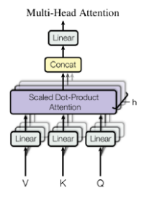
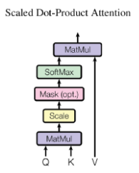
Transformer – Encoder
Like LSTM, Transformer is an architecture for transforming one sequence into another one with the help of two parts (Encoder and Decoder), but it differs from the existing seq2seq models because it does not imply any Recurrent Networks (GRU, LSTM, etc.).
3 main parts : Position Embeddings + Multi Head Attention + Feed- forward Layers.
Q (query) matrix : vector representation of one word in the sequence
K (keys) matrix : vector representations of all the words in the sequence
V (values) matrix : vector representations of all the words in the sequence. For the encoder, V consists of the same word sequence than Q.
Attention weights = softmax(QK^{T} /d_{k} )
These weights are defined by how each word of the sequence (represented by Q) is influenced by all the other words in the sequence (represented by K).
Those weights are then applied to all the words in the sequence that are introduced in V.

Slide 7
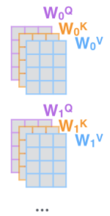
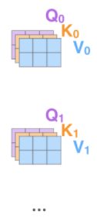

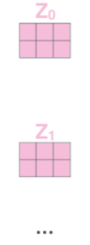
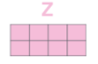
Multi-Head Attention
Split into number of heads and heads & also create learnable matrices
Multiply with learnable
matrices to get Q, K, V
Input Sequence
Embed each
word and add positional embedding
Calculate output of each head:
softmax(QK^{T} /d_{k} )V
Multihead attention allows the model to jointly attend to information from different representation subspaces and hence expands the model’s ability to focus on different positions
Concatenate
the resulting matrices to produce O/P

Slide 8


Slide 9
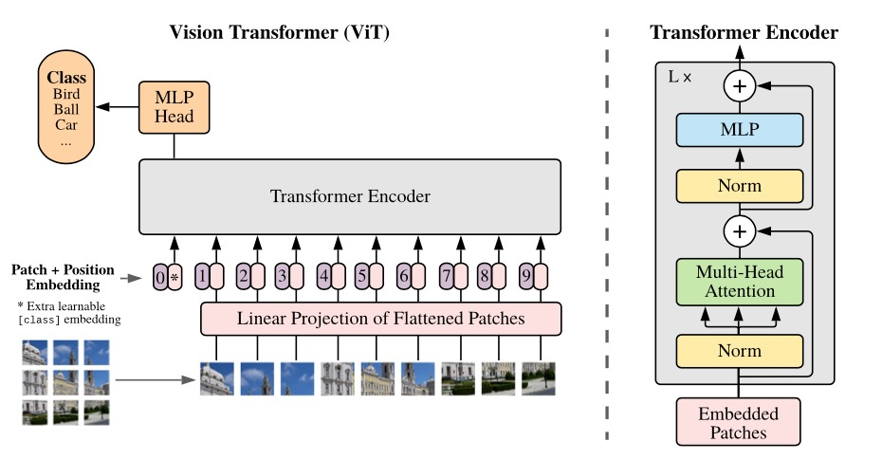
Model Architecture

Slide 10
Mathematics in Vision Transformer
Self-Attention Mechanism
Positional Encoding
The self-attention mechanism in ViTs can be formalized as a weighted sum of the values of all input tokens, where the weights are computed based on the similarity between the current token and all other tokens. This allows the model to dynamically focus on the most relevant parts of the input when making predictions.
To incorporate spatial information into the transformer, ViTs use positional encoding, which adds a learnable positional embedding to each input token. This helps the model understand the relative position of each patch within the input image.
Transformer Encoder
Loss Function
The transformer encoder in ViTs consists of a multi-head self-attention layer followed by a feed-forward neural network. This architecture enables the model to capture both global context and local features, leading to more powerful and expressive visual representations.
ViTs are typically trained using a standard cross-entropy loss function, which optimizes the model to minimize the difference between the predicted output and the ground truth labels. This loss function is backpropagated through the entire network to update the model parameters during training.

Slide 11
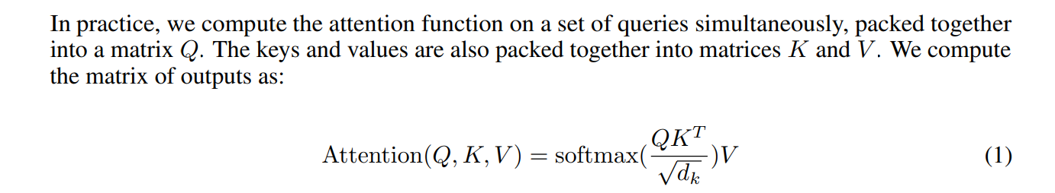
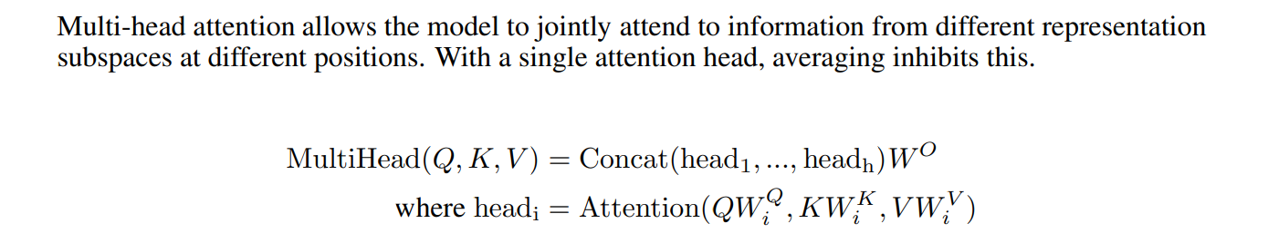
Attention & Multihead Attention Mathematics

Slide 12
Advantages of Vision Transformers over CNNs
Global Context Modeling
Scalability and Efficiency
Versatility and Transfer Learning
ViTs excel at capturing long-range dependencies and global context in visual data, which is a key limitation of CNNs. This allows ViTs to better understand the holistic relationships between different parts of an image, leading to more accurate and nuanced predictions.
ViTs are more scalable and computationally efficient than CNNs, especially for high-resolution images or video data. This is because the self-attention mechanism in ViTs can effectively process large input sizes without a significant increase in computational cost.
ViTs have shown remarkable versatility, performing well on a wide range of computer vision tasks, including image classification, object detection, and segmentation. Additionally, ViT models trained on large-scale datasets can be effectively fine-tuned for various downstream tasks, leveraging the rich visual representations learned during pre-training.

Slide 13




Training and Optimization of Vision Transformers
Data Preprocessing
Pre-training
Optimization Strategies
Regularization
To train ViT models effectively, the input images are typically divided into non-overlapping patches, which are then linearly projected into embedding vectors. This allows the model to efficiently process the visual data and learn the necessary spatial relationships.
ViT models often benefit from pre-training on large-scale datasets, such as ImageNet, to learn robust and generalizable visual representations. This pre-training step can then be followed by fine-tuning the model on specific downstream tasks, leveraging the acquired knowledge.
ViT training often involves the use of advanced optimization techniques, such as gradient accumulation, mixed precision training, and layer-wise adaptive rates, to improve convergence and stability. These strategies help to mitigate the computational challenges associated with training large transformer models.
To prevent overfitting and enhance the generalization capabilities of ViT models, various regularization techniques are employed, such as weight decay, dropout, and stochastic depth. These techniques help the model learn more robust and generalizable visual representations.

Slide 14




Applications of Vision Transformers
Image Classification
Object Detection
Semantic Segmentation
Medical Imaging
ViTs have also been adapted for object detection tasks, leveraging their ability to capture global context and long-range dependencies to better localize and classify objects within an image.
ViTs have shown promising results in medical imaging applications, such as disease detection and diagnosis, where their ability to extract meaningful features from complex medical images can lead to more accurate and reliable predictions.
ViTs have demonstrated state-of-the-art performance on a wide range of image classification tasks, outperforming traditional CNN-based models, particularly on large-scale, high-resolution datasets.
The flexibility of the ViT architecture allows it to excel in semantic segmentation tasks, where the model needs to assign a class label to every pixel in an image, capturing fine-grained details and spatial relationships.

Slide 15

Conclusion and Future Directions
Vision Transformers have emerged as a powerful and versatile deep learning model, capable of outperforming traditional Convolutional Neural Networks in a wide range of computer vision tasks. By leveraging the power of self-attention and global context modeling, ViTs have demonstrated remarkable capabilities in image classification, object detection, semantic segmentation, and various other applications. As the field of deep learning continues to evolve, the future of Vision Transformers holds great promise, with ongoing research exploring ways to further improve their efficiency, scalability, and adaptability to an even broader range of visual recognition challenges.

